Slide 1
Lambo Traders
Welcome to Lambo Traders

Slide 2
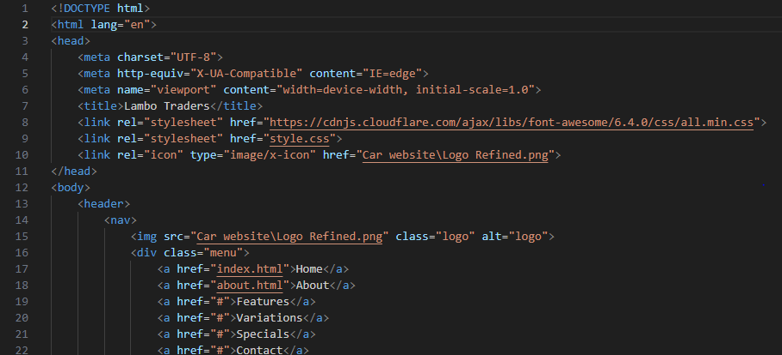
Here is our some html code of our website

Slide 3
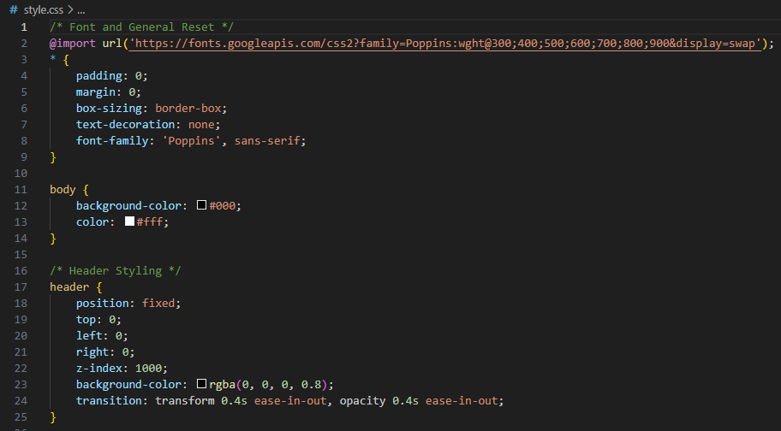
This is our CSS code

Slide 4
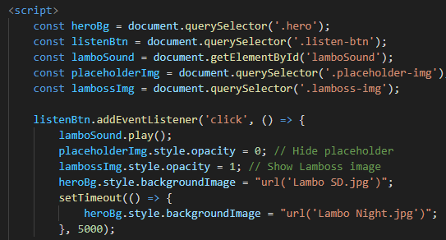
Our java script code

Slide 5

Our Home page

Slide 6
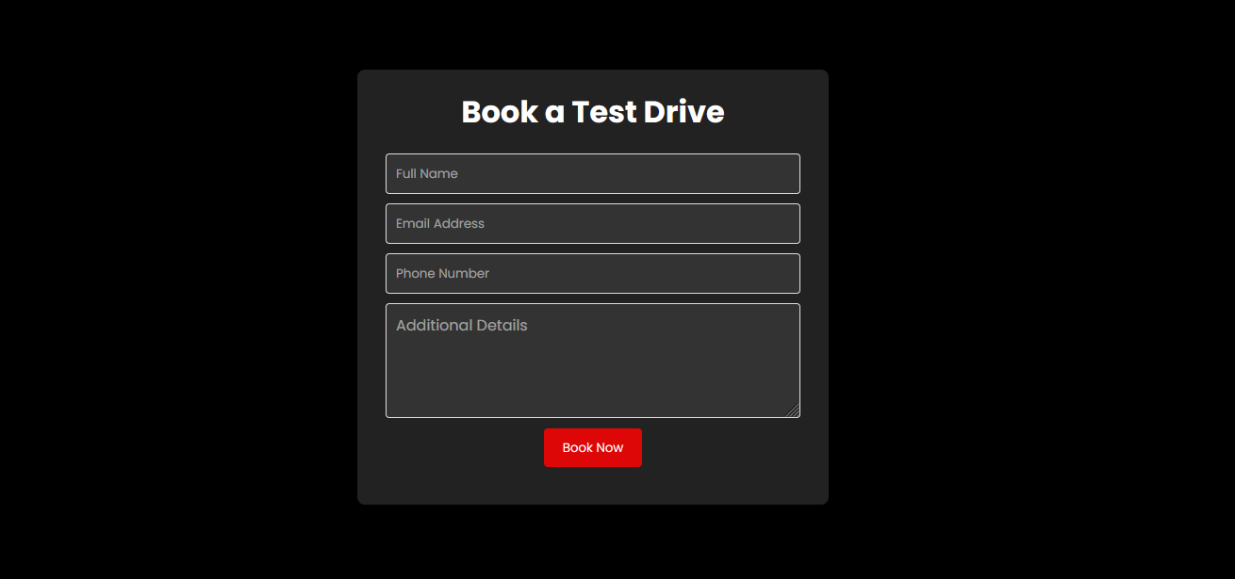
our test drive form

Slide 7
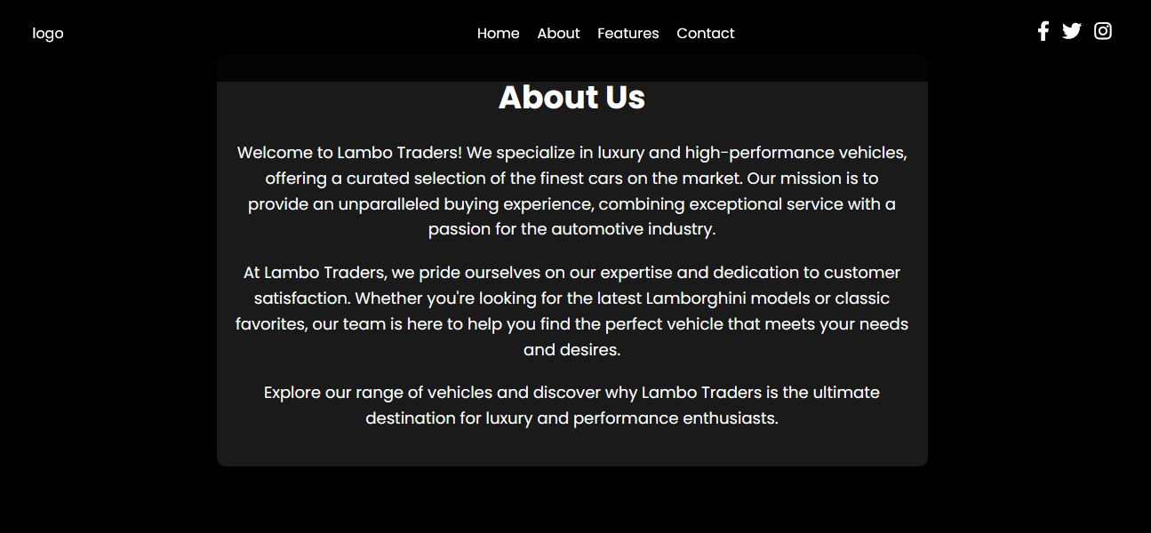
About us

